Slide 1
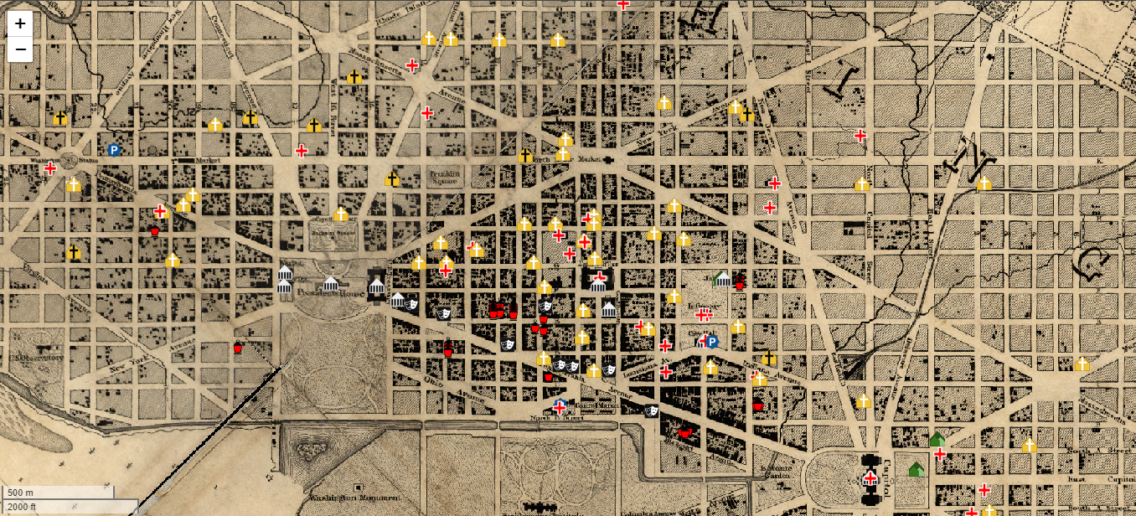
Albert Boschke 1860
Notes:
Civil War Washington

Slide 2
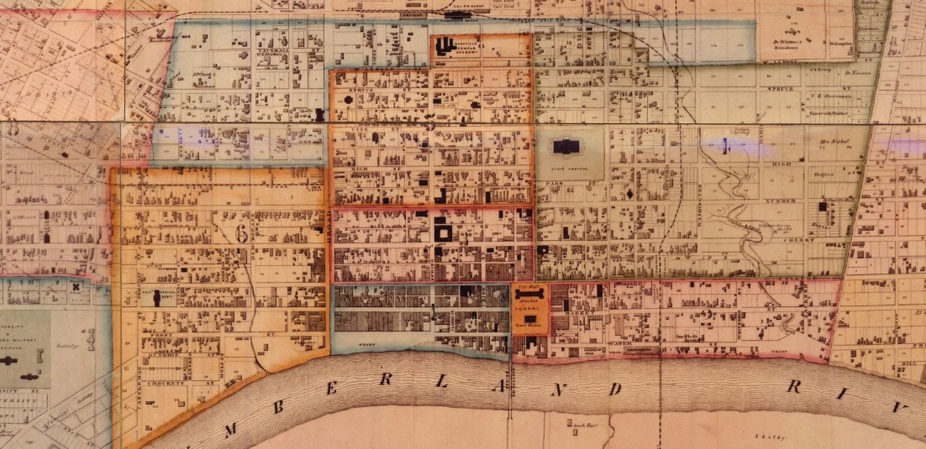
Hayden & Booth 1860
Notes:
Dissertation

Slide 3
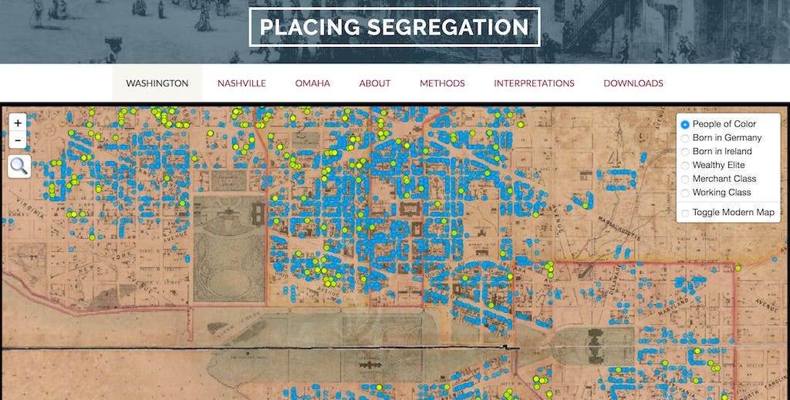
Albert Boschke 1857
Notes:
Placing Segregation

Slide 4
Mapping Chicagoland
NEH funded project to make over 4,000 maps of Chicago publicly available from:
UChicago Library|Newberry Library|Chicago History Museum
Workflow includes:
Scanning
Georeferencing (adding spatial data)
Enriching catalog records
Making available in public portals
UChicago Library
Chicago Collections
BTAA Geoportal

Slide 5
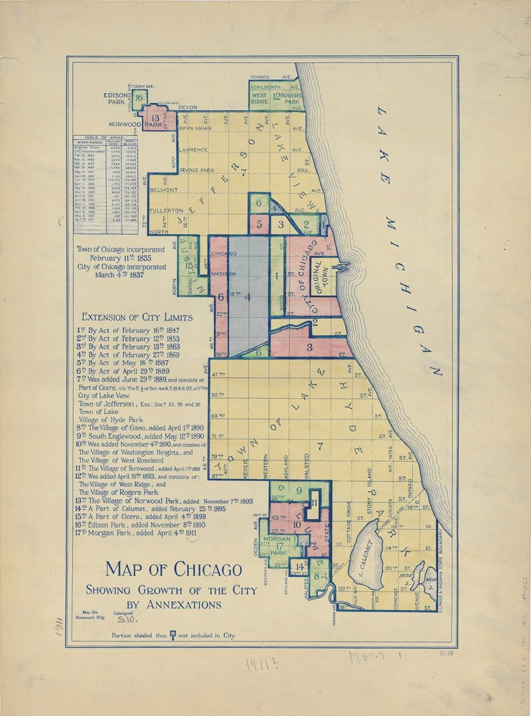
Mapping Chicagoland
UChicago – all our maps up to1940
Maps from 1853-1940
Social Science Research Committee
Transportation
Utility companies
Civic institutions
Topics covering social, urban, and economic features such as land use, parks, and urban planning.
Map of Chicago showing growth of the city by annexations [map]. Scale not given. Chicago: [Chicago], 1911. The University of Chicago Library.

Slide 6
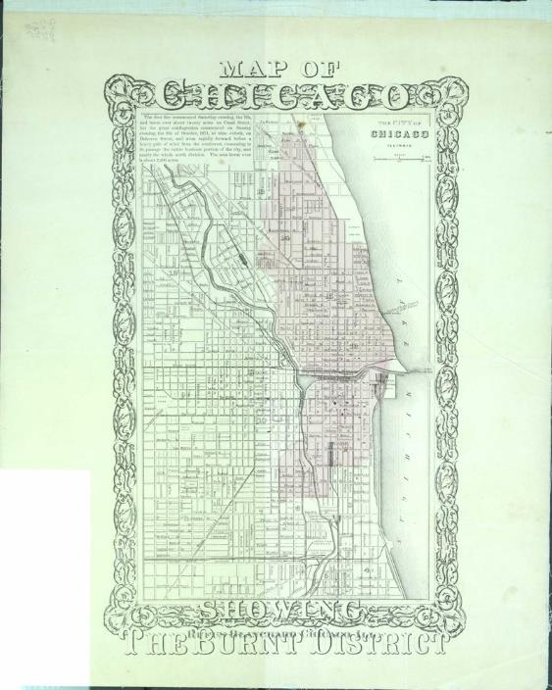
Mapping Chicagoland
Chicago History Museum – all maps up to 1940
Maps from 1812-1940
Annexations
Communities
Parks
Wards
Industries
Transportation
Topography
Cemeteries
Population
Map of Chicago Showing the Burnt District (1871) by Blanchard, Rufus. Chicago History Museum.

Slide 7
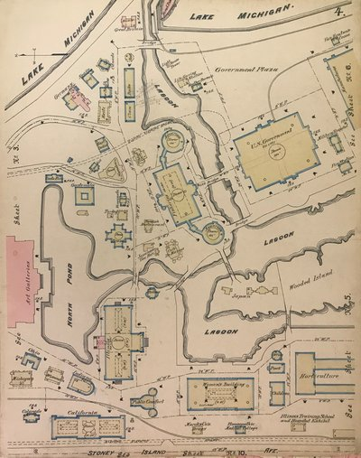
Mapping Chicagoland
Newberry Library – a selection of atlases
Maps from 1872-1924
Large-scale real estate
Fire insurance
Land valuation
The atlases show footprints of individual structures and lots, providing large scale details for studying Chicago’s cultural geography.
Yerkes, Chas. S. Insurance map of the World's Columbian Exposition, Jackson Park, Chicago. 152 Monroe Street, Chicago: Chas. S. Yerkes, April, 1893. Newberry Library.

Slide 8
Mapping Chicagoland
Intellectual Content
The proposed collections range from the earliest cartographic representations of Chicago prior to its incorporation through its rapid expansion in the early 20th century.
1800-1849
Fort Dearborn established on Indigenous land
Growing number of civilian settlers
Plats laid and purchased by long distance investors
Incorporated as a town in 1833 and city in 1837
First railroad completed and Michigan & Illinois Canal

Slide 9
Mapping Chicagoland
1850-1899
30,000 residents in 1850
Mass production of maps for business and travel
Great Fire 1871
Over half a million residents by 1880
World’s Columbian Exposition 1893
1900-1940
Over 1.6 million residents
A time of “Big Plans,” e.g. Plan of Chicago 1909
Great Migration begins
1919 Race Riots
A Century of Progress Exposition 1933
Mapping in social urban research
Over 3.3 million residents

Slide 10
Mapping Chicagoland
Scholarly Interest:
History
Music
Culture
Art
Race
Identity
Sociology
Urban Studies

Slide 11
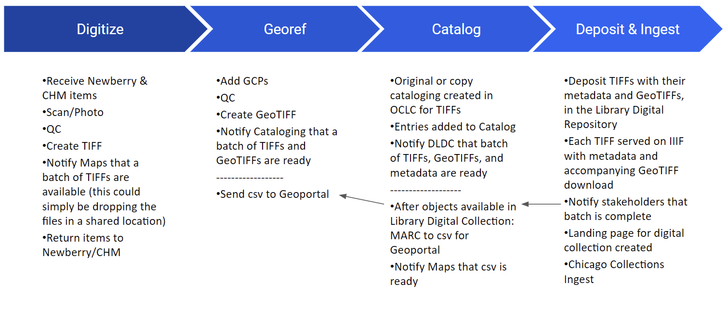
Mapping Chicagoland
Fall 2024 completion

Slide 12



Slide 13
Mapping Chicagoland
In Fall 2024 maps will be publicly discoverable through:
UChicago Library Digital Collections
Chicago Collection’s Explore Platform
BTAA Geoportal

Slide 14
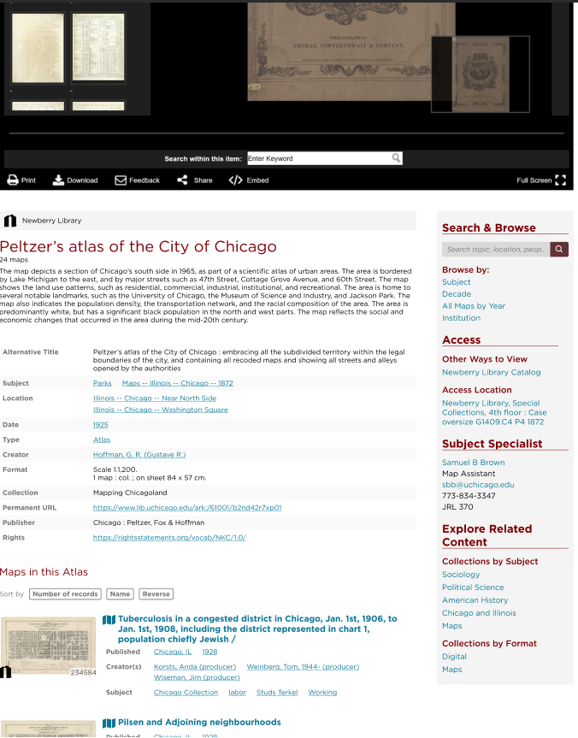
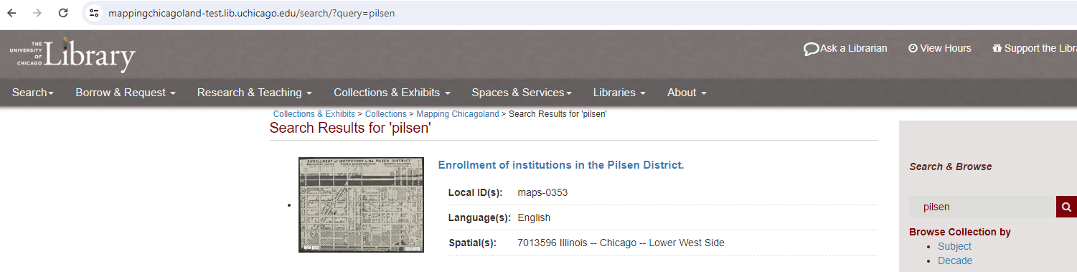
Interface Mockups
(shh)

Slide 15
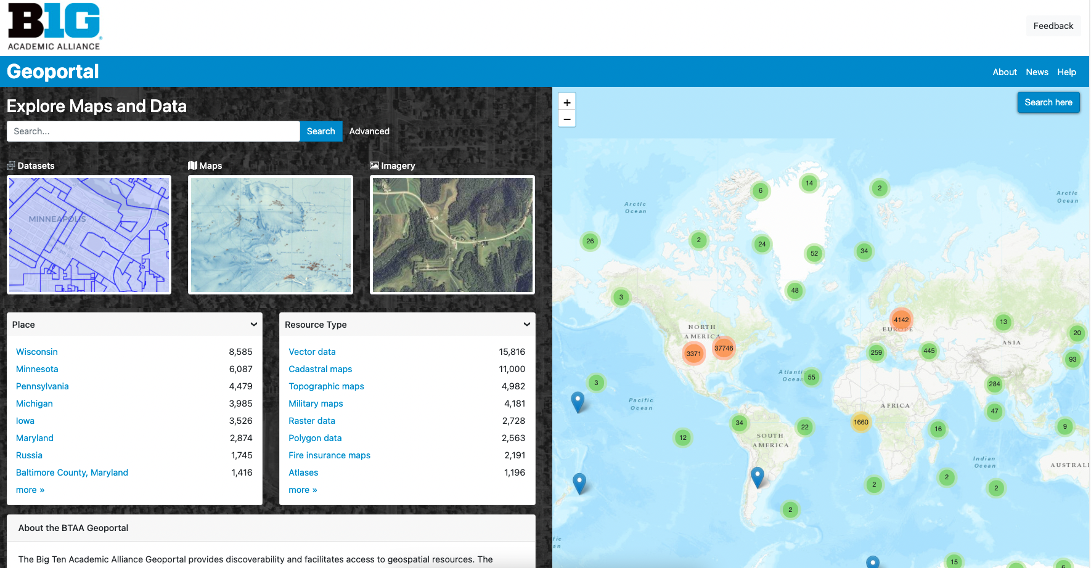
Big Ten Academic Alliance Geoportal

Slide 16
What happens next…?

Slide 17
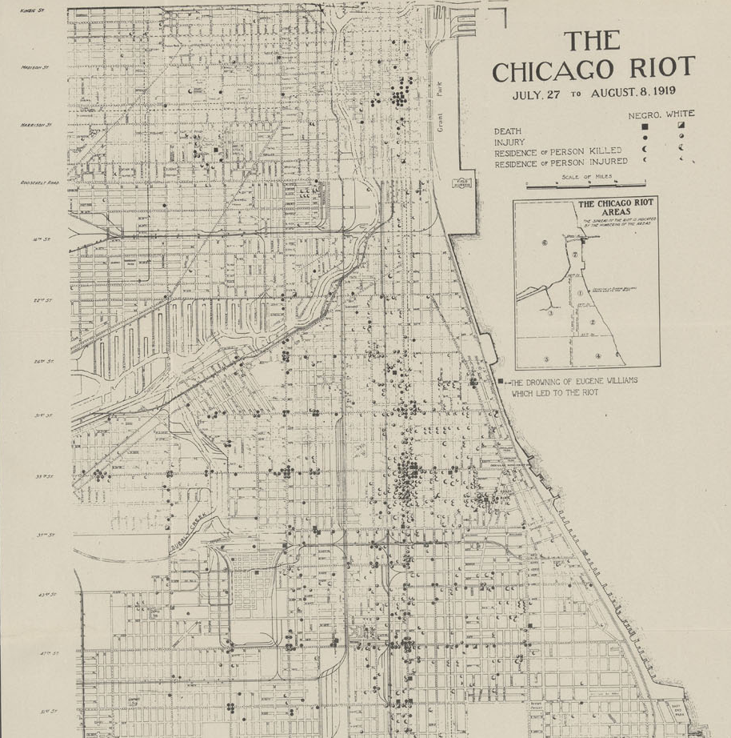
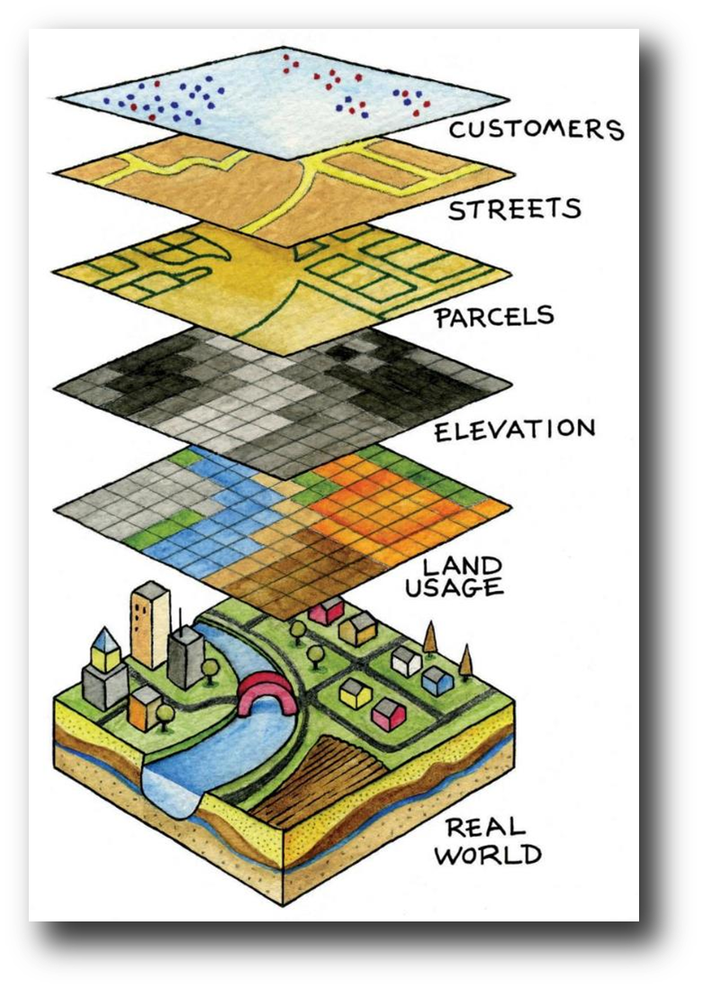
Data mining opportunities

Slide 18
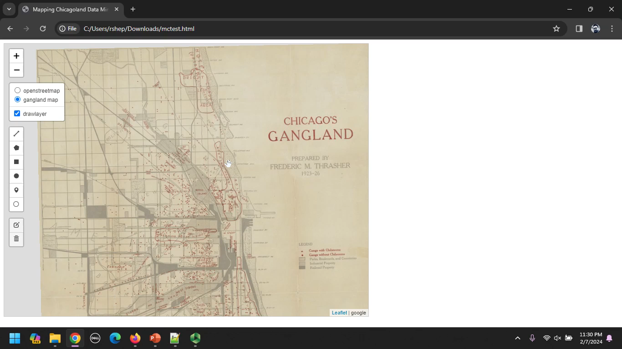
What happens next…?
https://allmaps.xyz/maps/da2b72099eaa12d7/{z}/{x}/{y}.png

